Slide 1
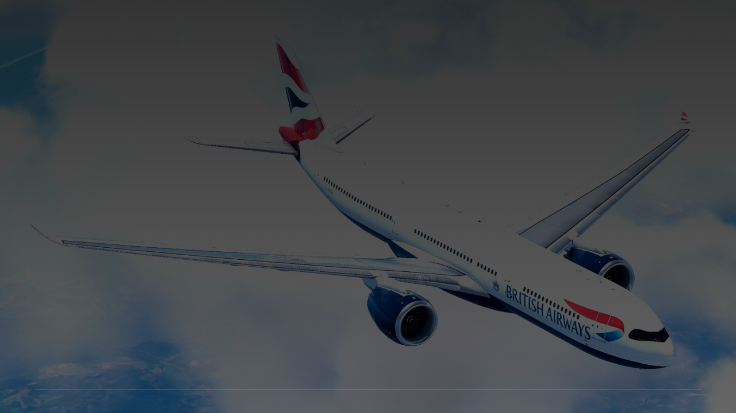
British Airways
Booking Analysis
Data Science Insights & Behavior Analytics
PREPARED FOR STRATEGY OPTIMIZATION

Slide 2


CHAPTER 01
Performance Overview

Slide 3
Executive Summary
Metric | Observed Value | Benchmark / Goal
Total Sample Volume | 50,000 Records | High Confidence
Completion Rate | 14.96% | Target: 18.00%
Avg Purchase Lead Time | 84.9 Days | Plan Window
Avg Length of Stay | 23.0 Days | Holiday/Business

Slide 4
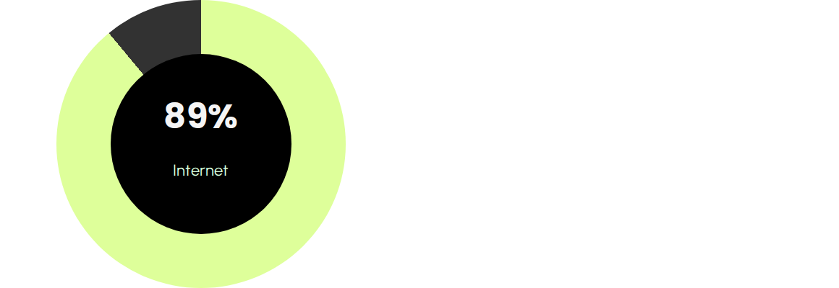
Sales Channel Composition
Channel Dominance
The Internet channel accounts for the vast majority of volume. Mobile represents 11% but is the fastest growing segment.
•
Internet Volume: 44,500
•
Mobile Volume: 5,500

Slide 5
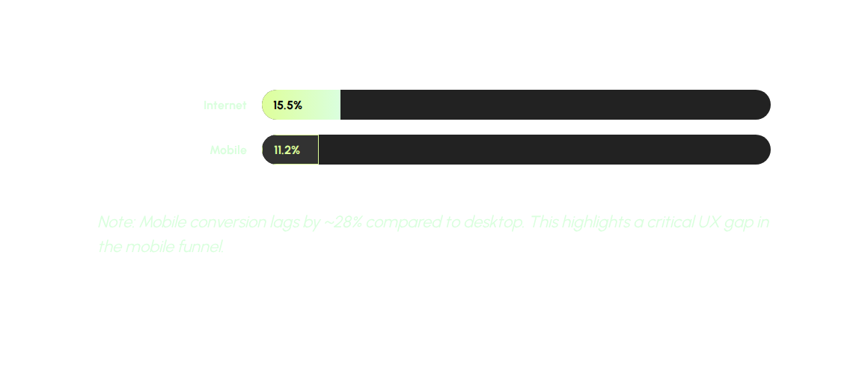
Conversion by Channel

Slide 6






Ancillary Service Demand
Extra Baggage
In-flight Meals
Preferred Seat
65%
42%
29%
Highest Demand Add-on
Consistent Uptake
Upsell Opportunity

Slide 7


Global Origin Dynamics
Top markets by volume include Australia, Malaysia, and South Korea.
APAC markets show higher propensity for ancillary additions but lower lead-time sensitivity.
Strategic Insight: Marketing budget should be localized to top APAC origin cities to capture high-value long-haul travelers.

Slide 8
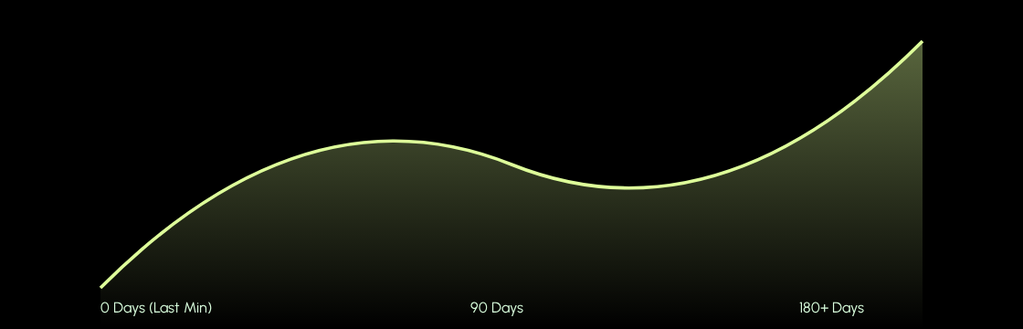
Lead Time vs. Conversion
Conversion probability peaks for bookings made between 60 to 90 days in advance.

Slide 9

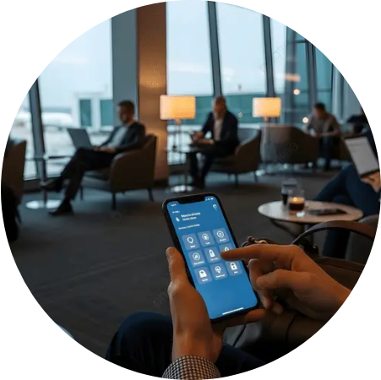
Optimizing Mobile UX
Bridging the Gap
With an 11% volume share, mobile is a critical touchpoint. Current data suggests travelers research on mobile but switch to web for completion.
Focus Areas:
•
Streamlined checkout process
•
One-click ancillary selection
•
Localized payment methods

Slide 10
The Growth Opportunity
Revenue Projection
14.96%
Increasing completion rate by just 2% through targeted bundling of baggage and preferred seating could result in a significant uplift in annual revenue.
Data shows customers who select 2+ ancillaries are 40% more likely to complete their booking.
Current Completion Rate

Slide 11



Strategic Roadmap
Bundled Ancillary Offerings
Introduce "Travel Plus" packages that include baggage and seat selection at a 15% discount vs. individual items.
Dynamic Pricing for Early Bookers
Leverage the 85-day lead time window with sliding-scale pricing to incentivize immediate conversion.
Mobile Funnel Re-Engineering
Audit and optimize the mobile path to purchase, focusing on reducing friction in origin markets with high mobile usage.

Slide 12
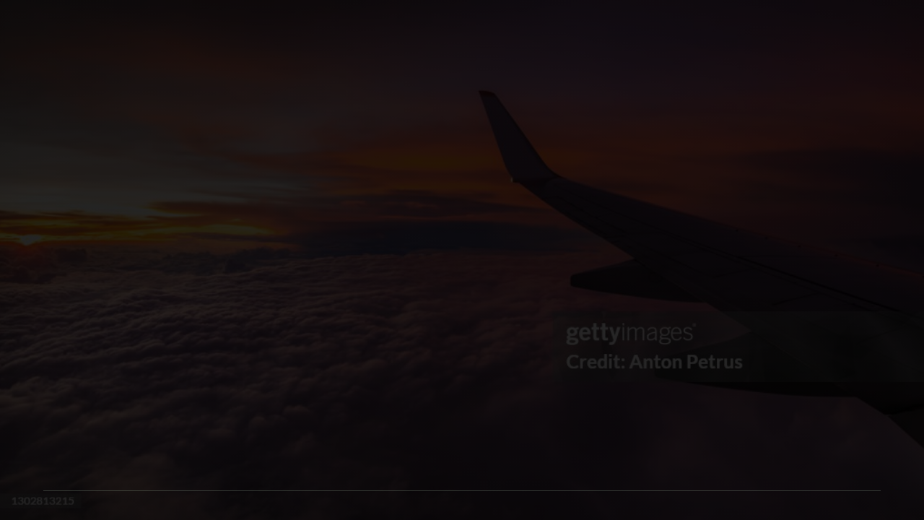
Thank You
Any Questions?
British Airways Strategy Team
www.britishairways.com

Slide 13




Image Sources
http://www.billfrymire.com/gallery/weblarge/world-map-relief-connections-blue-v.jpg
Source: www.billfrymire.com
https://png.pngtree.com/thumb_back/fw800/background/20251128/pngtree-man-using-smartphone-in-a-modern-airport-business-lounge-with-other-image_20444567.webp
Source: pngtree.com
https://cdn.x-plane.to/images/01/british-airways-g-neon-a330-900-x-works-mod-for-lr-a330-xp12-kJKmD.jpg?width=1400&auto_optimize=medium
Source: x-plane.to
https://media.gettyimages.com/id/1302813215/photo/view-from-the-airplane-window-on-a-beautiful-sunset-above-the-clouds.jpg?s=1024x1024&w=gi&k=20&c=aLnDY4MlsNvN75JXKSxP3oF9ki-MG_LqA7VHEuRMgq8=
Source: www.esseg.eu

